Slide 1


N.s.s. management system 1.0
A Software by absa’s java developer's

Slide 2
1. Project summary
Introduction
The NSS Management System 1.0 is a very interactive and fast software which really lets user to save his time and keeps him off from all the tedious jobs for finding records and doing all the stuff.
The most striking feature of the software is that it has been provided with a very simple and fast procedure to manage work form adding new Student to generating his report.
In the same way the software has been provided with the management of all information Activity or task which is completed by the NSS Students.

Slide 3
1.1 modules involved are:
Login for Admin (Only Single User) & Student / with Password Recovery
Student Details Adding, Updating by Admin & Student Also
Maintenance Of Student Details
Adding Activities
Search Key for Student, Activity. It Uses The Unique Id For Searching The Records
Generating Reports
Exporting The Data In .xlsx (Excel) Format
Last but Not Least, admin can send Notice through Email, admin can send mail to all students, sorted students with 4 types of filter’s
Notes:
© Copyright PresentationGo.com – The free PowerPoint template library

Slide 4
2. Requirement's
Software Requirement’s
Operating System -:
Windows XP (Any Service Pack)
Windows 7, 8, 8.1, 10 (both 32-bit & 62-bit)
Software’s -:
PDF viewer
MySQL 8.0 or Latest
JDK 1.8 or Latest
Microsoft Excel 2007 or higher / Any Excel viewer
Programming Language -:
Java (frontend)
Java (backend)
Structured Query Language (SQL) (Database)
Type of Connection -:
JDBC
Designed & Developed with-:
Apache NetBeans IDE 11.2
MySQL Client Server 8.0

Slide 5
Hardware Requirement’s
Processor -:
Intel Pentium-III or above, 600 MHz
RAM -:
Minimum 256 Mb RAM Required For System
Hard Disk -:
Total Disk Size Minimum 800 MB or More
Free Space 1.5 Gb or More
Screen Resolution -:
1024 x 786, 256 Colour Resolution Minimum

Slide 6
3. Feasibility study
Feasibility study is made to see if the project on completion will serve the purpose of the organization for the amount of work, effort and the time that spend on it.
The document provide the feasibility of the project that is being designed and lists various areas that were considered very carefully during the feasibility study of this project such as Technical, Economic and Operational feasibilities. The following are its features:
Notes:
© Copyright PresentationGo.com – The free PowerPoint template library

Slide 7
3.1 Types of feasibility study
1. TECHNICAL FEASIBILITY:-
The system must be evaluated from the technical point of view first. The assessment of this feasibility must be based on an outline design of the system requirement in the terms of input, output, programs and procedures. Having identified an outline system, the investigation must go on to suggest the type of equipment, required method developing the system, of running the system once it has been designed.
Technical issues raised during the investigation are:
Does the existing technology sufficient for the suggested one?
Can the system expand if developed?

Slide 8
2. ECONOMIC FEASIBILITY
The developing system must be justified by cost and benefit. Criteria to ensure that effort is concentrated on project, which will give best, return at the earliest. One of the factors, which affect the development of a new system, is the cost it would require.
The following are some of the important financial questions asked during preliminary investigation:
The costs conduct a full system investigation.
The cost of the hardware and software.
The benefits in the form of reduced costs or fewer costly errors.

Slide 9
4. Entity relationship diagram (E.r.d.)
S_Name
Unit
Phno
Gender
DOB
E_Id
Email
Student
Class
1
Aadhar
T_Name
F_Name
Weight
addr
T_No
T_Loc
Parents
Height
Activity
T_Cash
T_Dur
M
T_Expenc
DO

Slide 10
5. Data flow diagram (D.F.D.)
Context level DFD
Admin
Fill Information
Done by Student
Activity
Login
Login
0.0
NSS Management System 1.0
Verified
Give Activity
Student
Give Information
Teacher
Student
UsrLog
Activity
Task_stud

Slide 11
First level dfd
Admin
1.0
Authentication
User Details
UsrLog
Admin
1.1
User Login
Username & Password
Permission Granted
Validation & Verification
Admin
UsrLog

Slide 12
second level dfd
Admin
2.0
Student Master
Admin Maintain
Student details
Student
Add details
Student
Admin
2.1
Student data add update delete
Student
Update & Delete data
Student

Slide 13
Third level dfd
Admin
User maintain activity details
3.0
Activity Master
Activity
Add Details
Activity
Admin
3.1
Activity data updating, deleting
Delete and update data
Activity
Activity

Slide 14
Fourth level dfd
Admin
4.0
Activity Assignment
Stud_Task
Maintain student and activity details
Stud_Task
Student
Student takes task from activities
Stud_Task
4.2
Activity completion
Admin assign task
Stud_Task
4.3
Certificate
Activity
Stud_Task
Student

Slide 15
Fifth level DFD
Student
5.0
Report’s Authentication
Activity
Stud_Task
Report Generation
Admin Login
Student
Activity
Stud_Task
Admin

Slide 16
6. Data Dictionary
Student Data-Set
Field | Data Type | Constraints
E_Id | Int | Primary Key
S_name | Text | Not null
Gender | Text | Not null
DOB | Text | Not null
Class | Text | Not null
Nu_No | Text | Not null
Ph_no | Text | Not null
Email | Text | Not null
Adh_no | Text | Not null
Weight | Text | Not null
Height | Text | Not null
Par_nm | Text | Not null
Addr | Text | Not null
Pinc | Text | Not null
Image | Text | Not null
Bl_grp | Text | Not null
S_Year | Text | Not null

Slide 17
Activities Data-Set
Field | Data Type | Constraints
T_No | Int | Primary Key
T_Name | Text | Not null
F_Name | Text | Not null
T_Loc | Text | Not null
T_Dur | Text | Not null
T_Year | Text | Not null
T_Expences | Text | Not null
Image | Text | Not null
Allo_Cash | Text | Not null

Slide 18
Student & Task Data-Set
Field | Data Type | Constraints
T_No | Int | Not null
S_No | Int | Not null
T_Name | Text | Not null
S_Name | Text | Not null
Class | Text | Not null
T_Dur | Text | Not null
A_No | Int | Primary Key

Slide 19
User Log Data-Set
Field | Data Type | Constraints
Username | Text | Primary Key
Password | Text | Not null

Slide 20
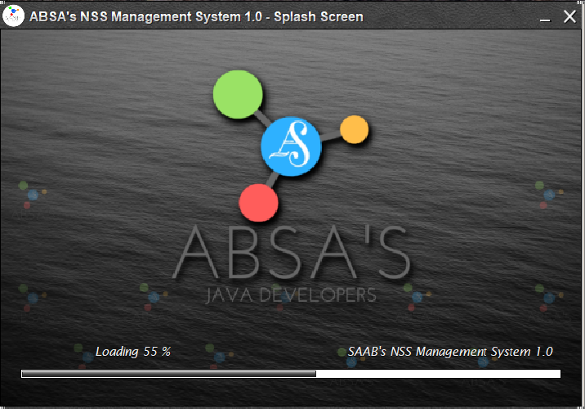
7. Screen shots of user interface
Splash Screen

Slide 21
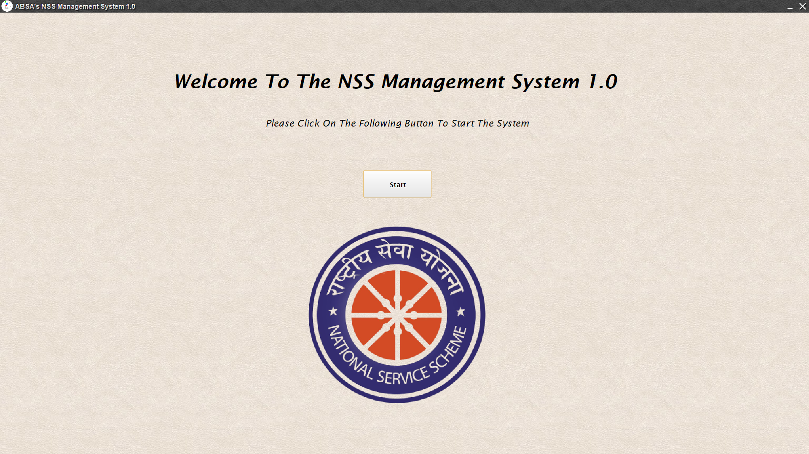
Welcome Screen

Slide 22
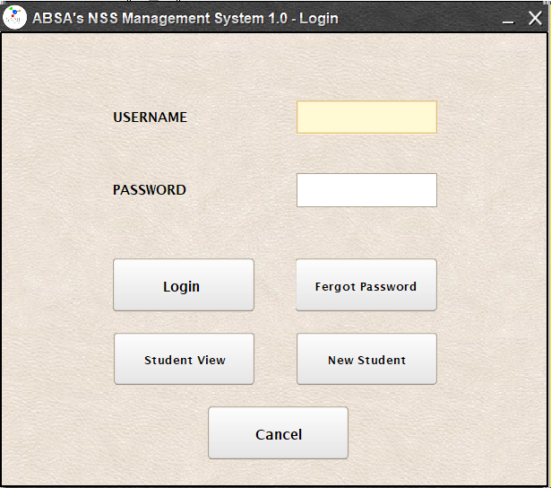
Login Screen

Slide 23
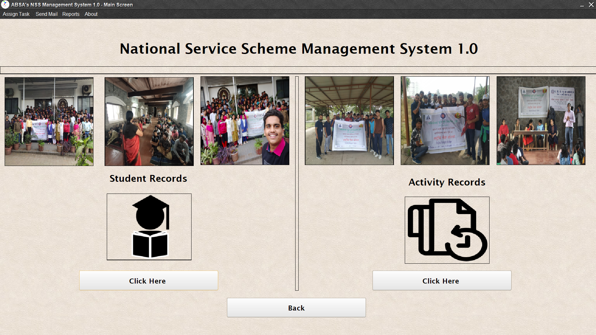
Main Screen

Slide 24
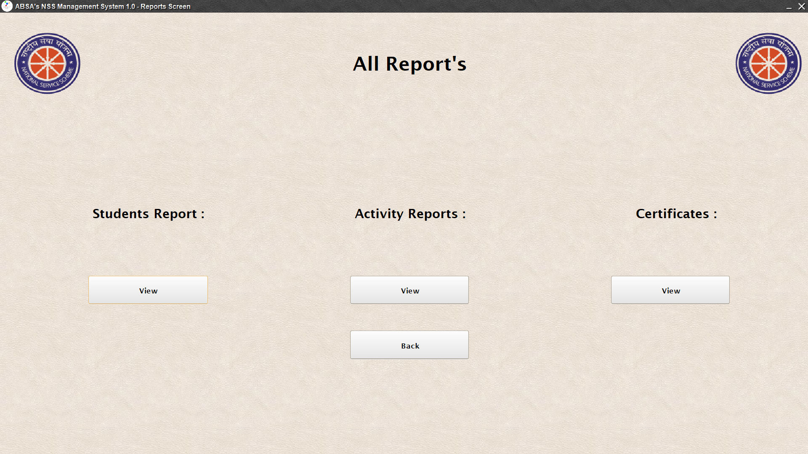
Reports screen

Slide 25
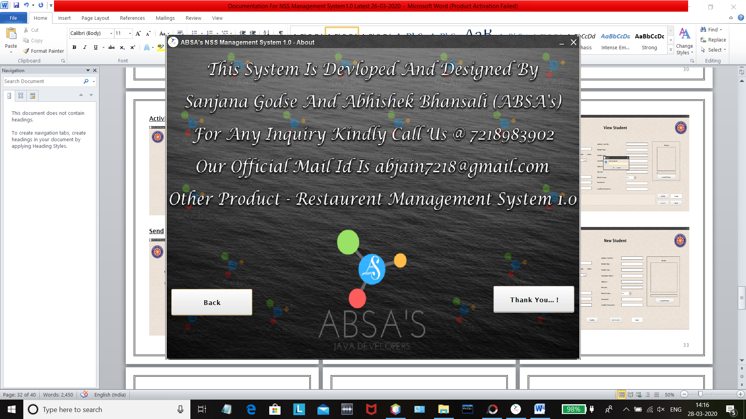
About Screen

Slide 26
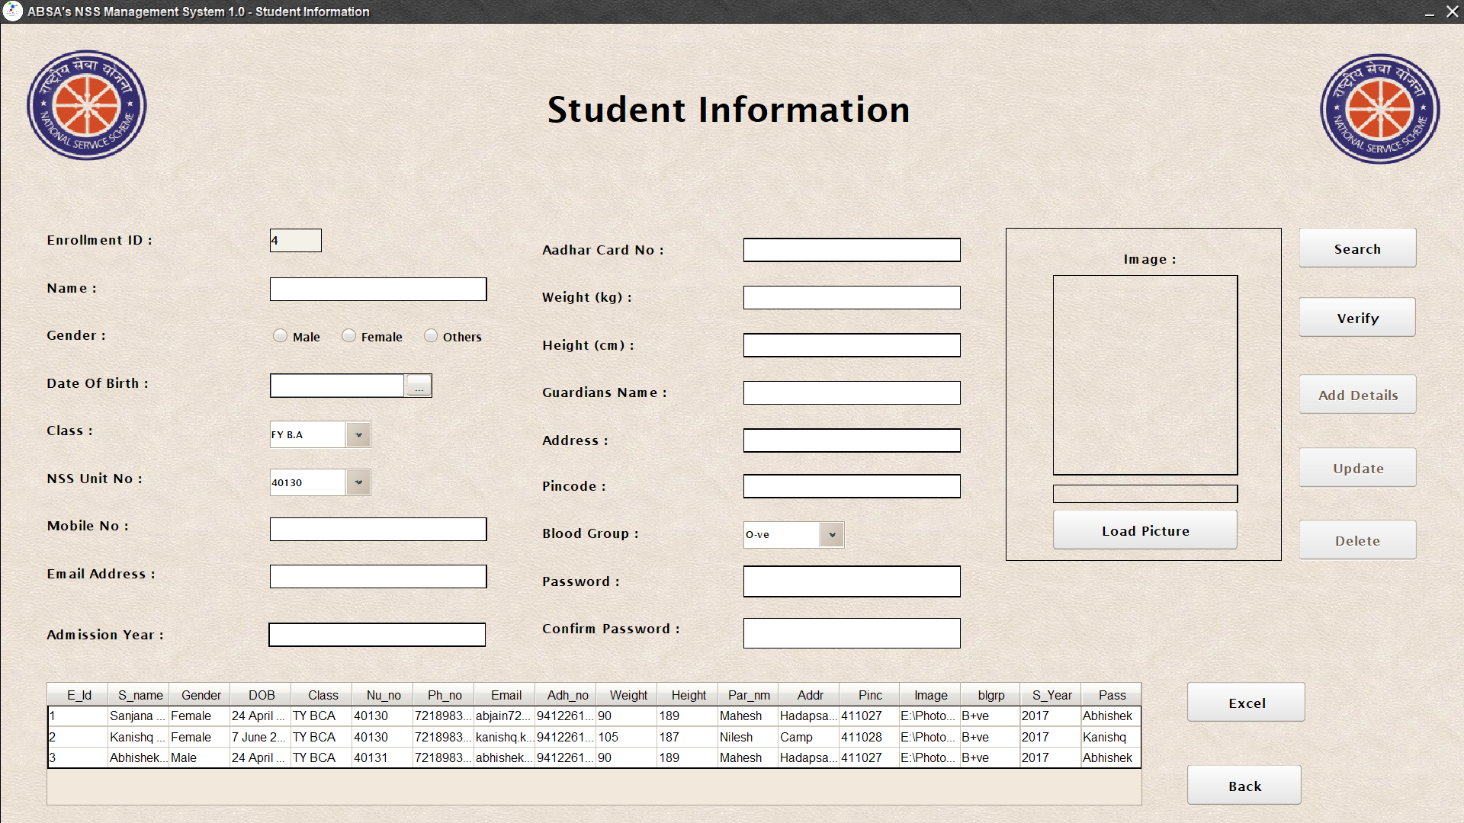
8. Forms in the project
7.1 Admin’s corner
Student information

Slide 27
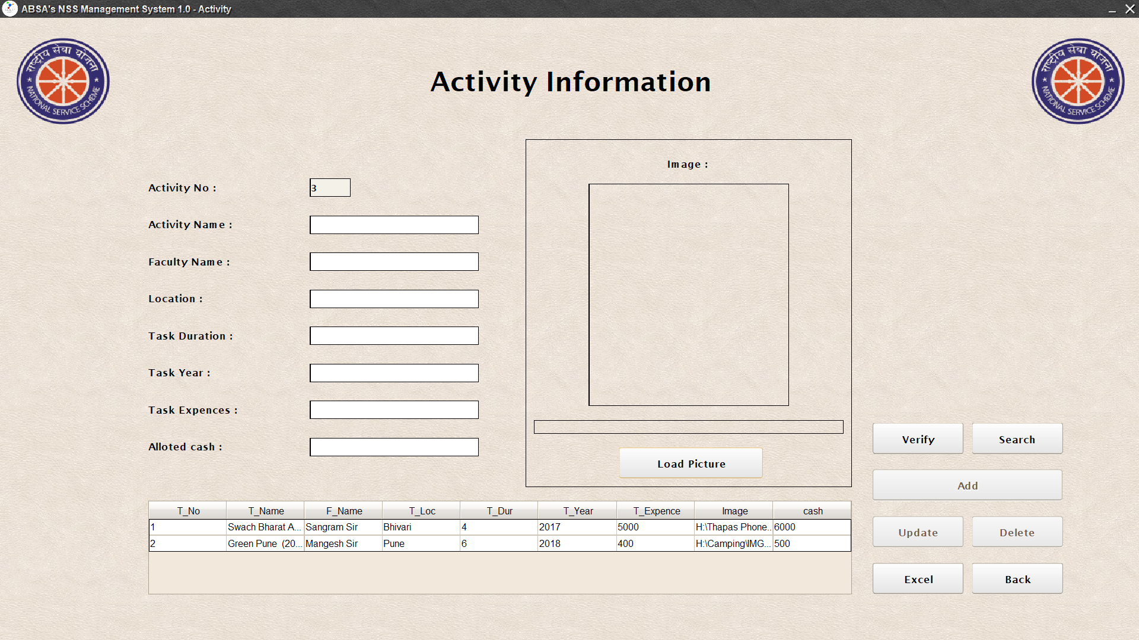
Activity information

Slide 28
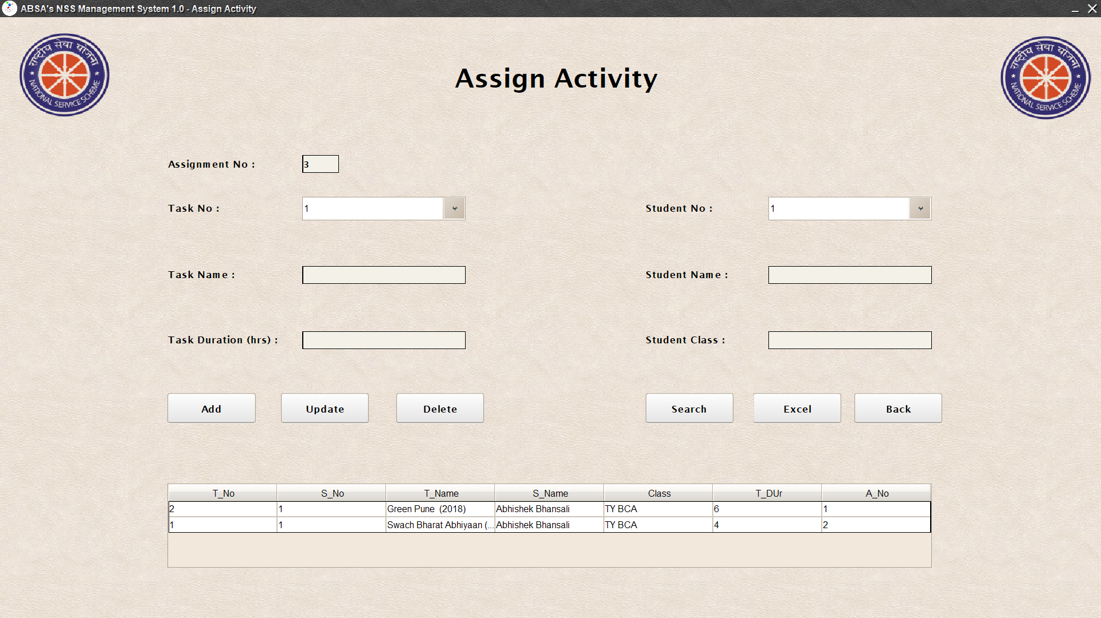
Activity Assign Details Screen :-

Slide 29
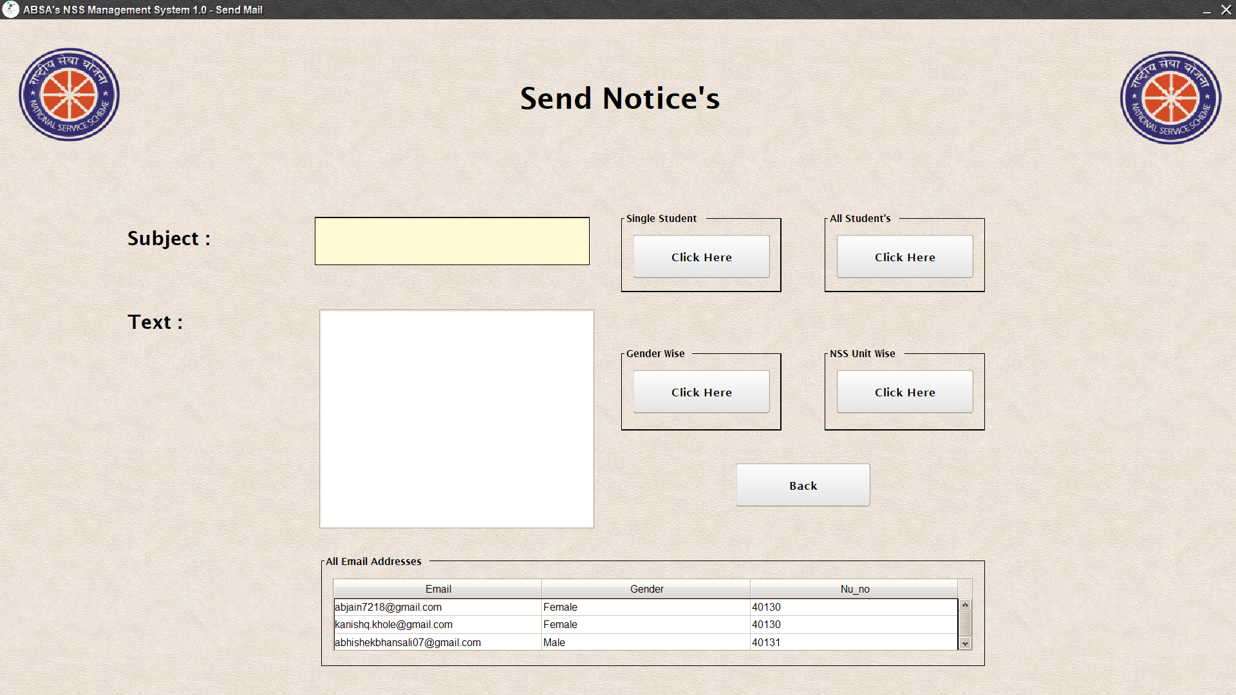
Send Notice screen

Slide 30
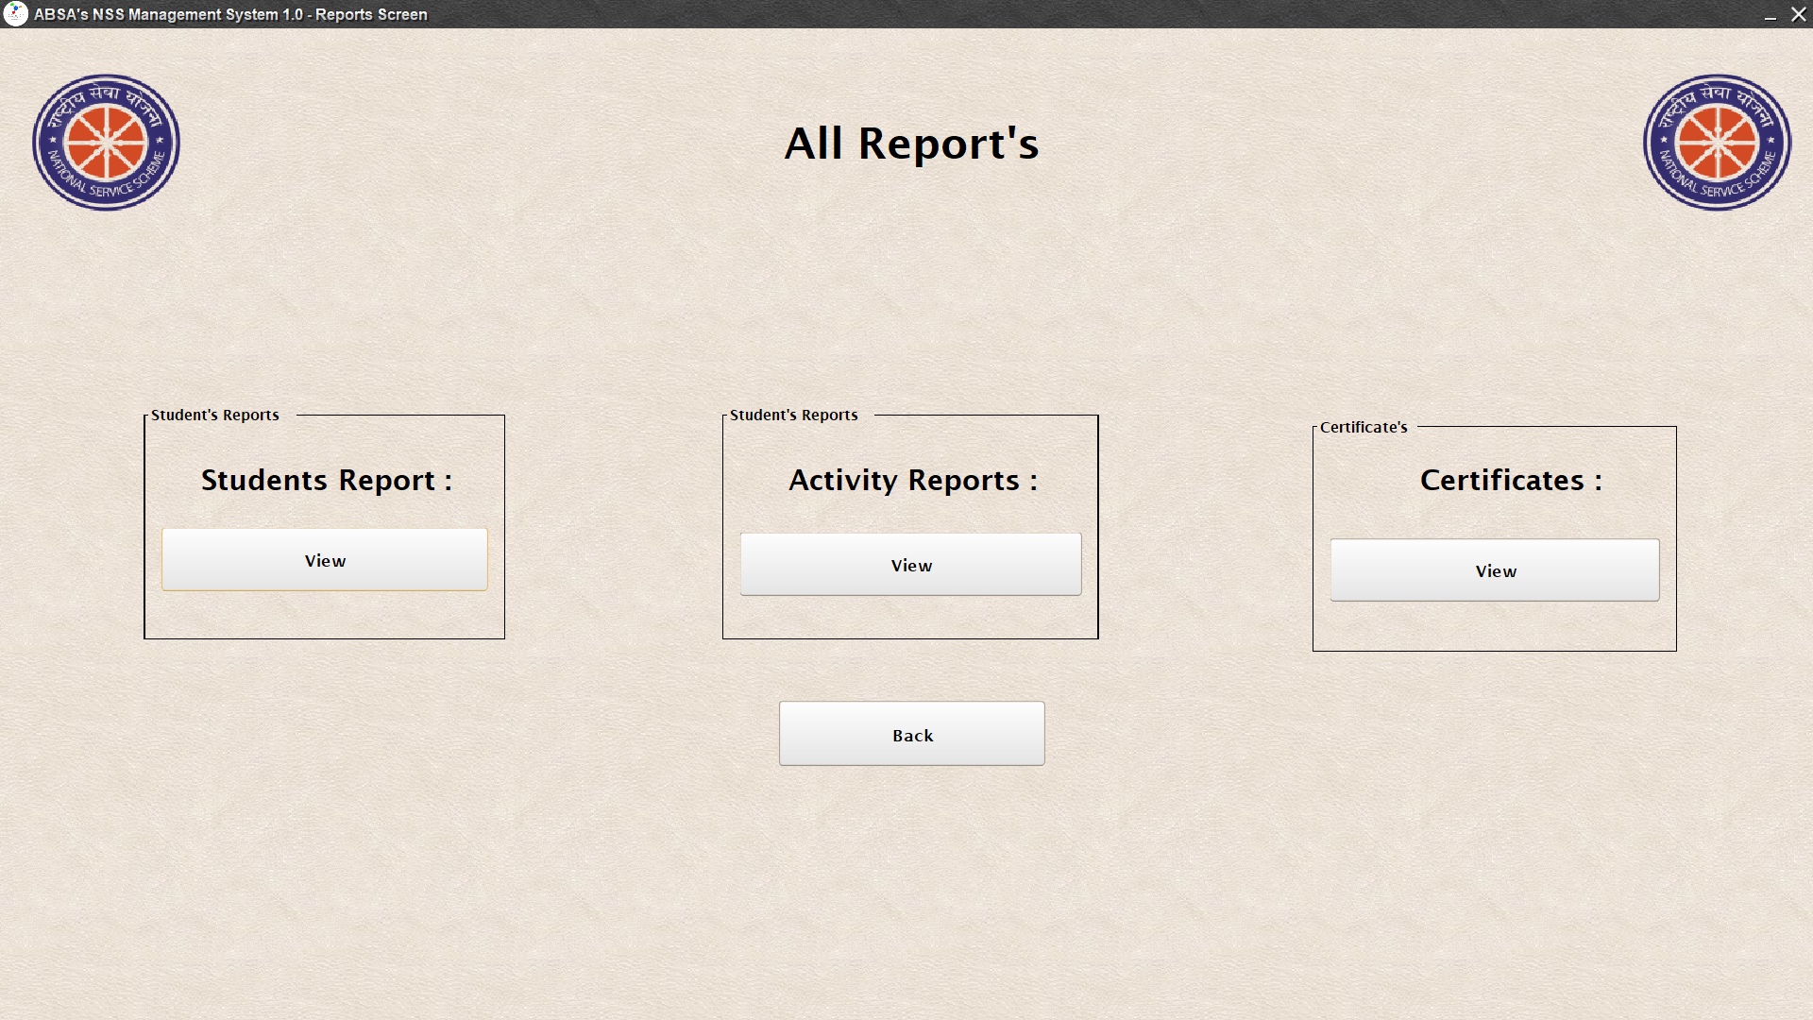
All Reports Screen

Slide 31
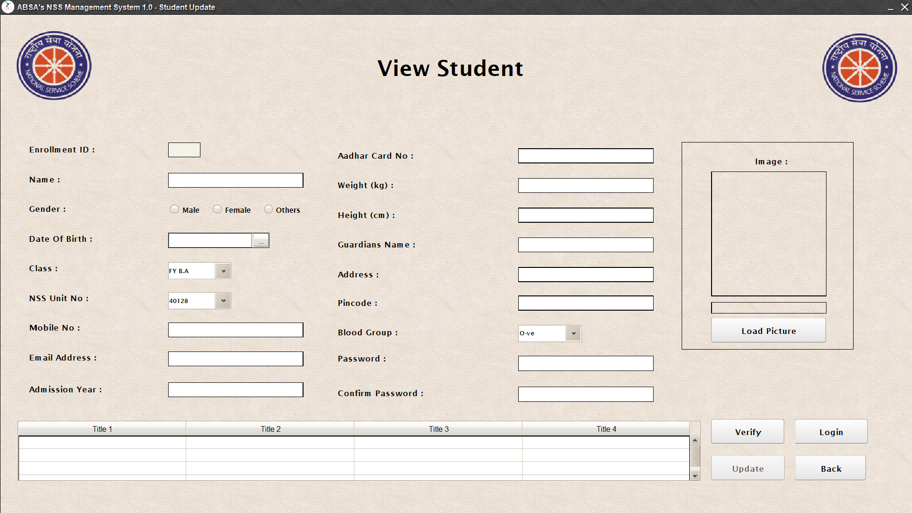
8.2 Students corner
View Student

Slide 32
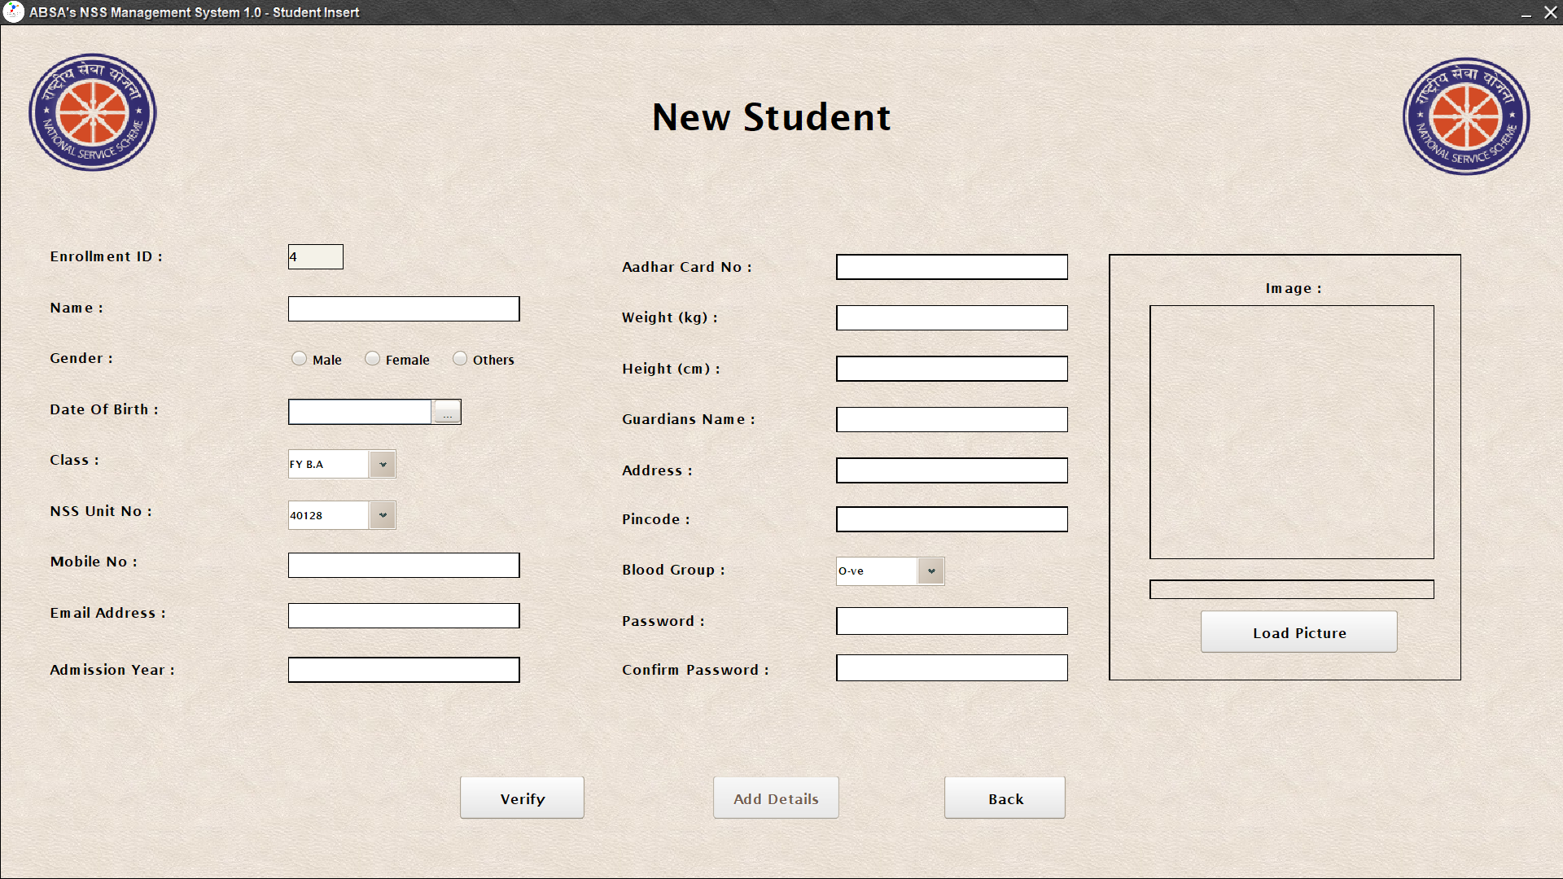
New Student

Slide 33
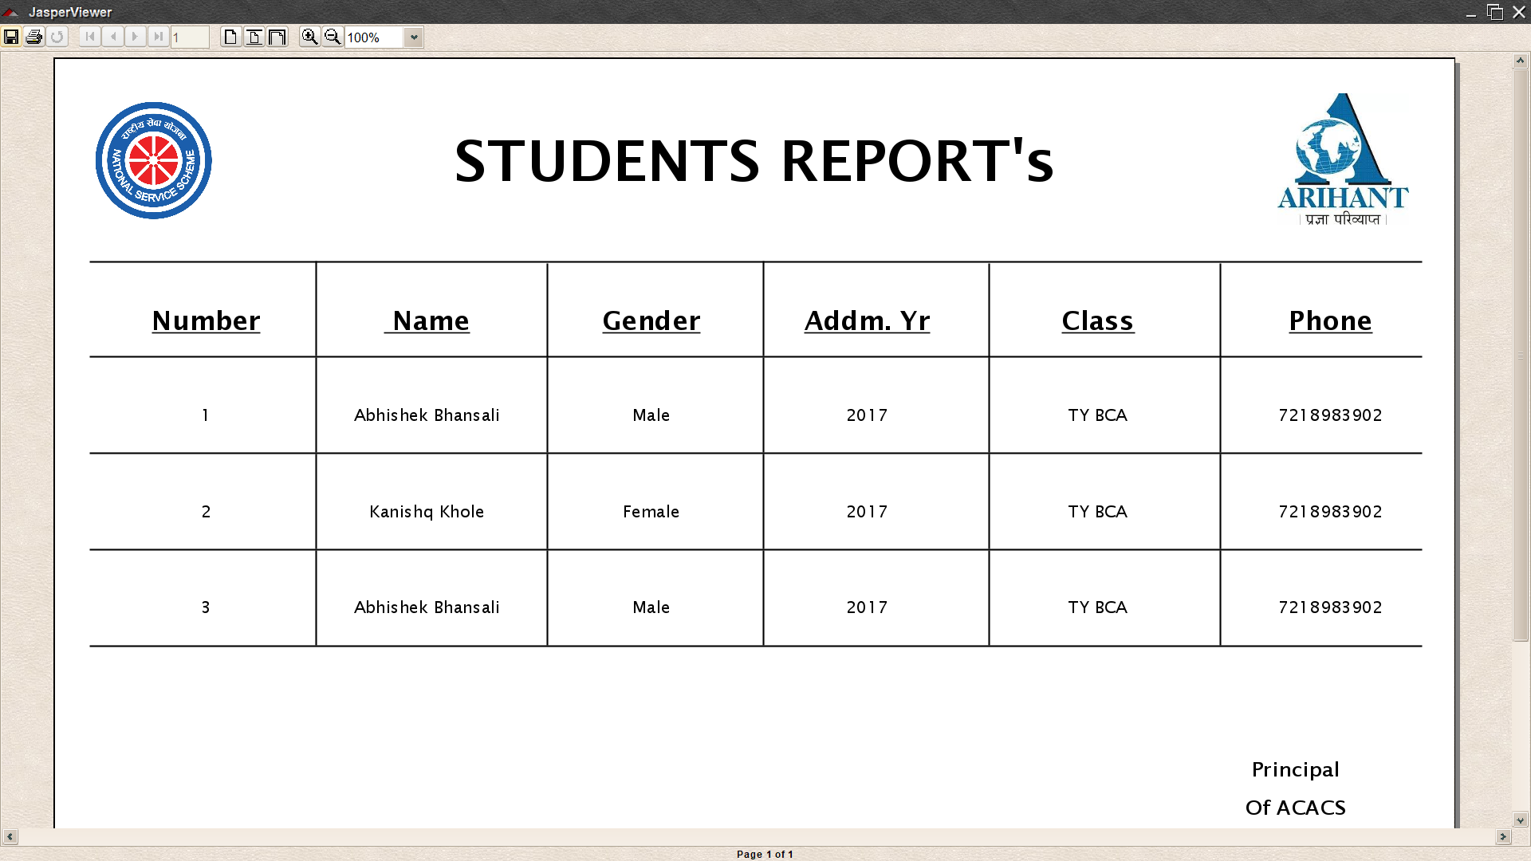
9. Report’s (Jasper Report)
Student Report

Slide 34
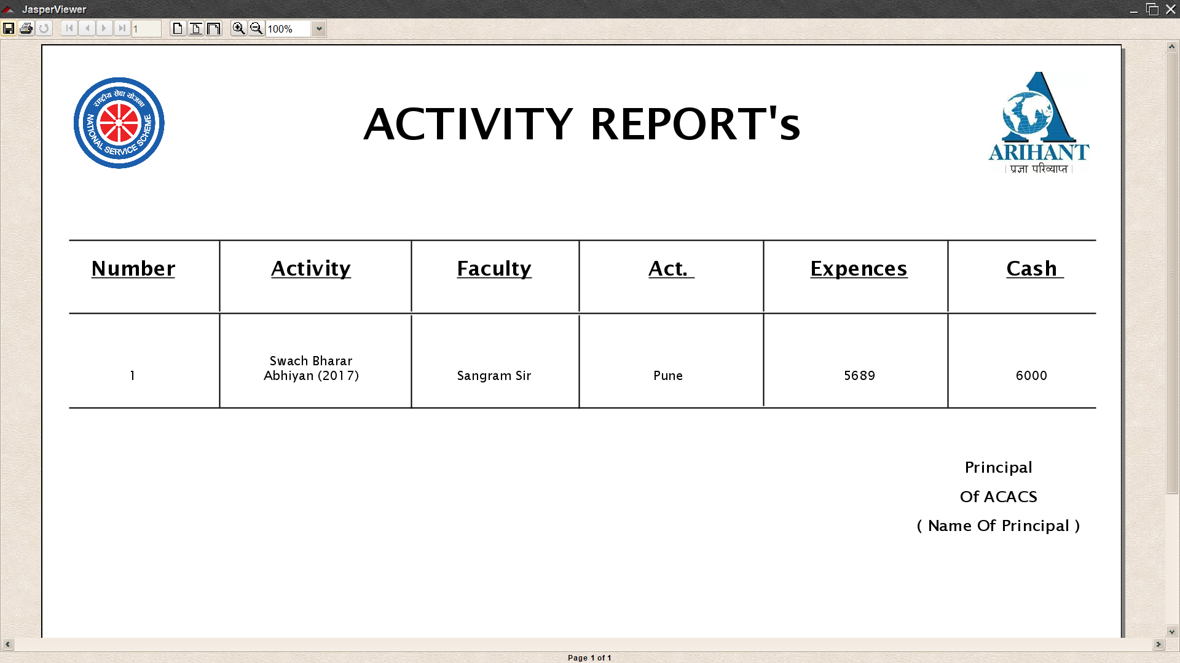
Activity Reports

Slide 35
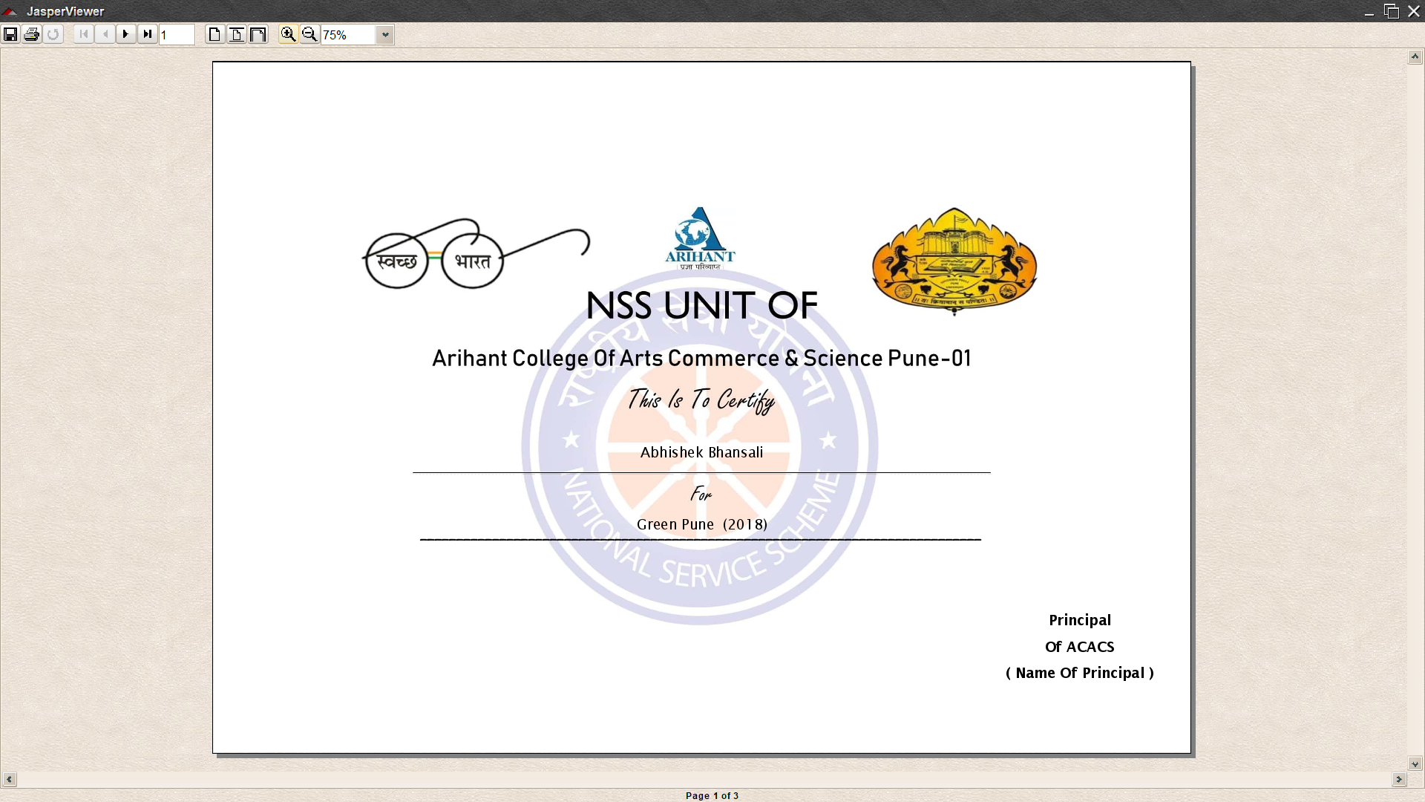
Certificates

Slide 36
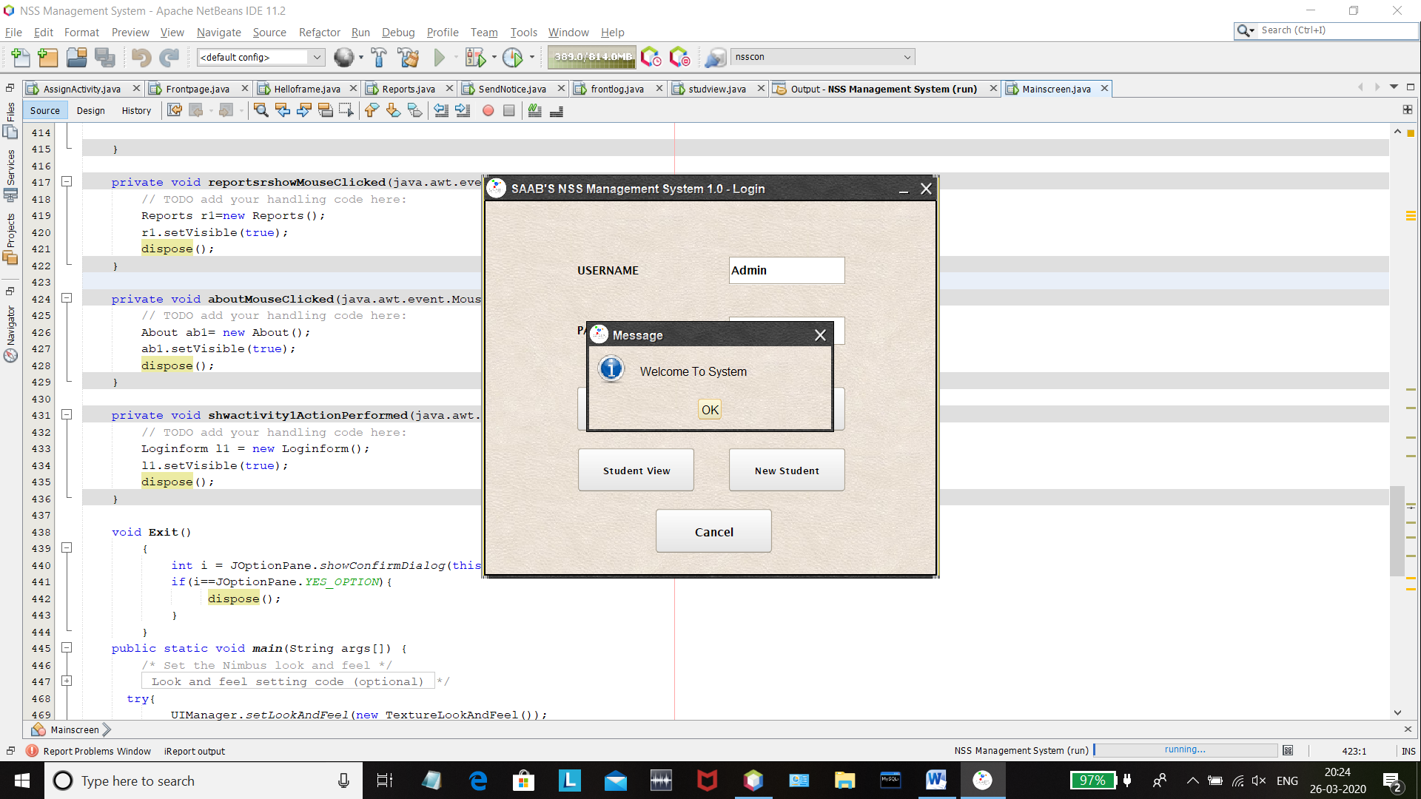
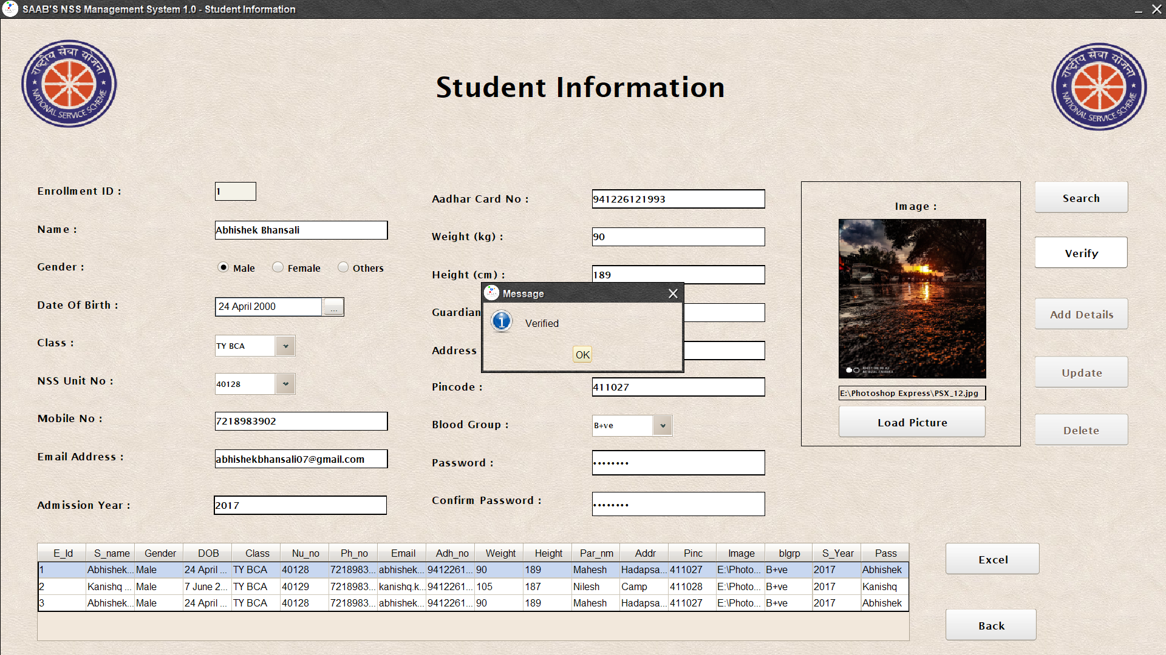
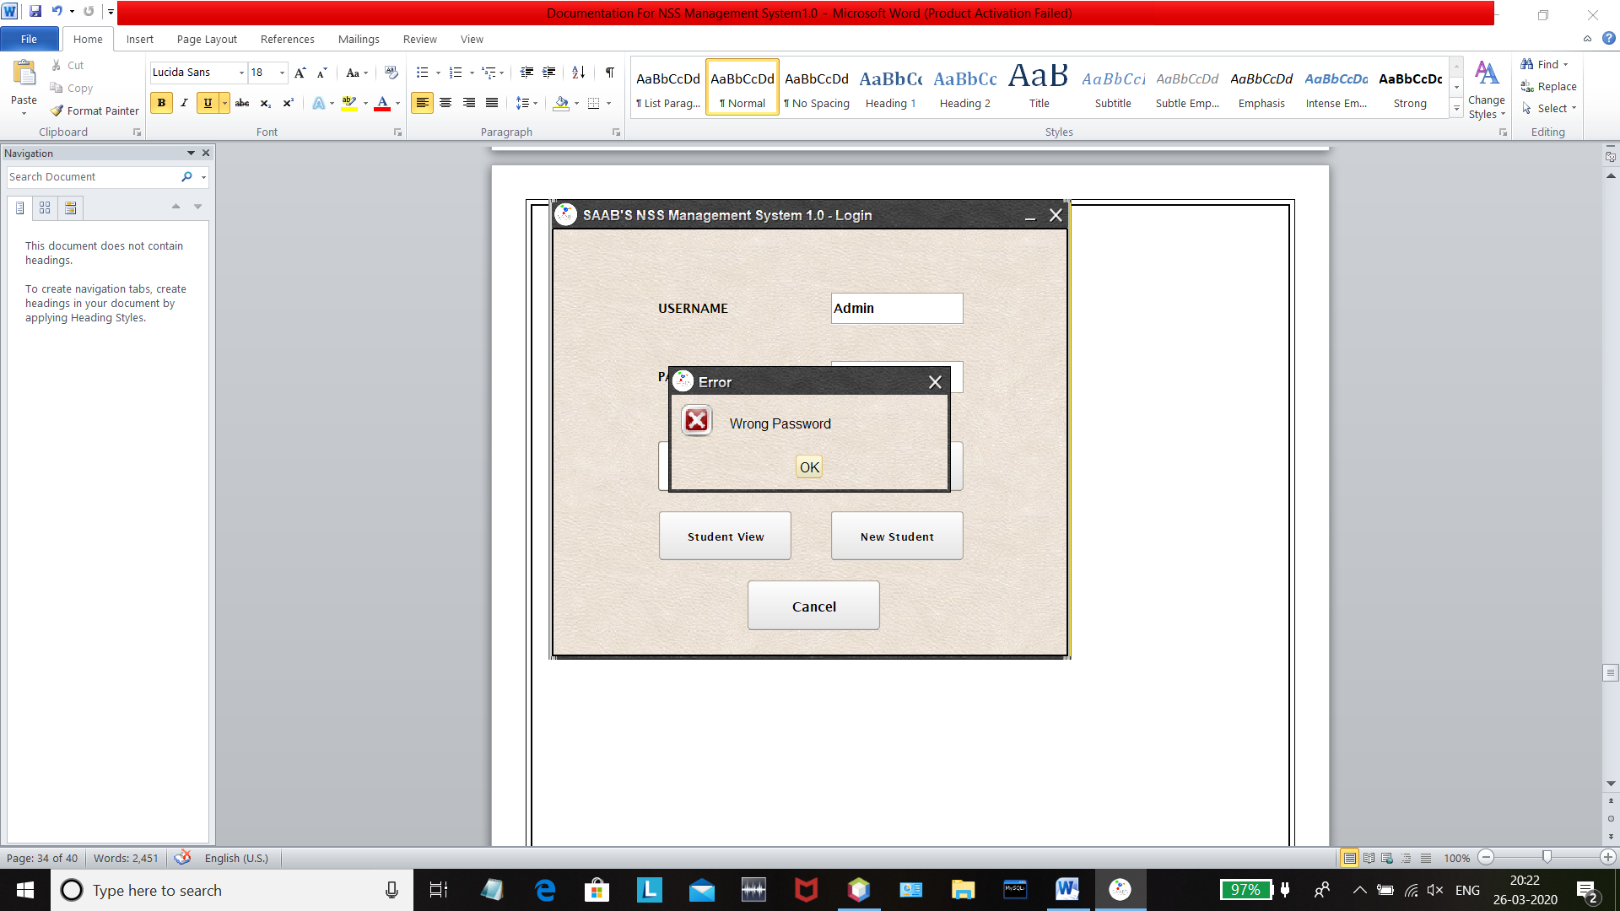
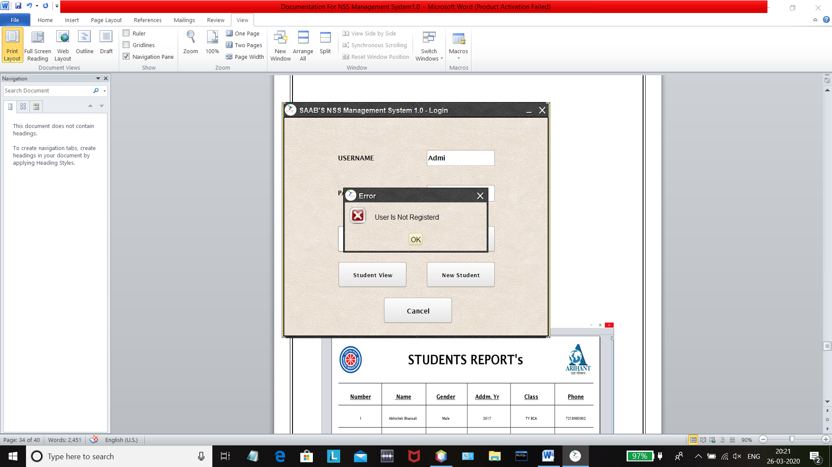
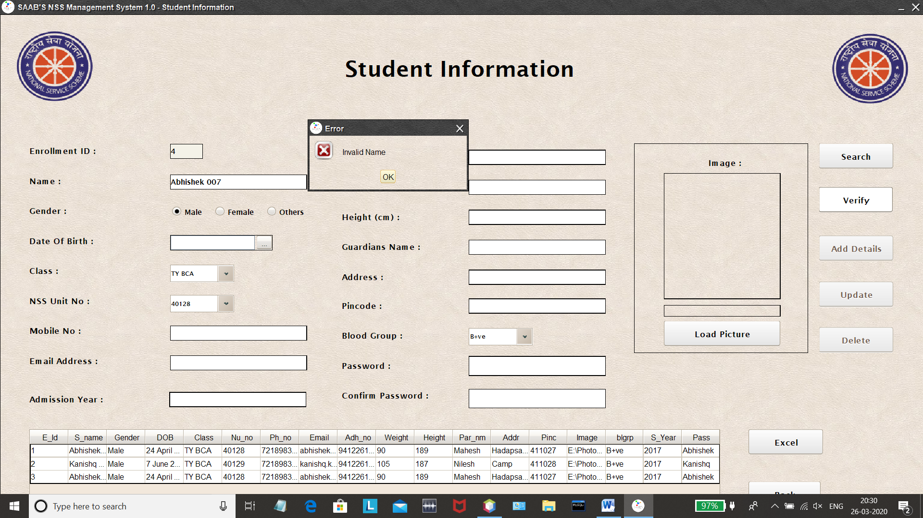
Validation's

Slide 37
10. Limitations
This system is created with the help of jdk 13 and on some platforms it works slower because of some bugs
In NSS Management System some glitches are there because of the front end is also designed in java and it is slower than other technologies
Mail sending is old technology in the world of Whatsapp but trying to provide free API for sending message on whatsapp with python platform technologies

Slide 38
11. FUTURE ENHANCEMENTS
We Can Update This System Into Fully Functionally Online System Also With The Help Of Network Component’s To Take Input From Student Directly With The Help Of JSP
The Bugs And Some Logical Errors Will Solved In The Next Update
Class wise Or Unit Wise Excel file can be Exported In Next Update
Student Gallery Will Also Added In the next Update for Students
Individual Student And Teacher Login Will provided In Next Update

Slide 39
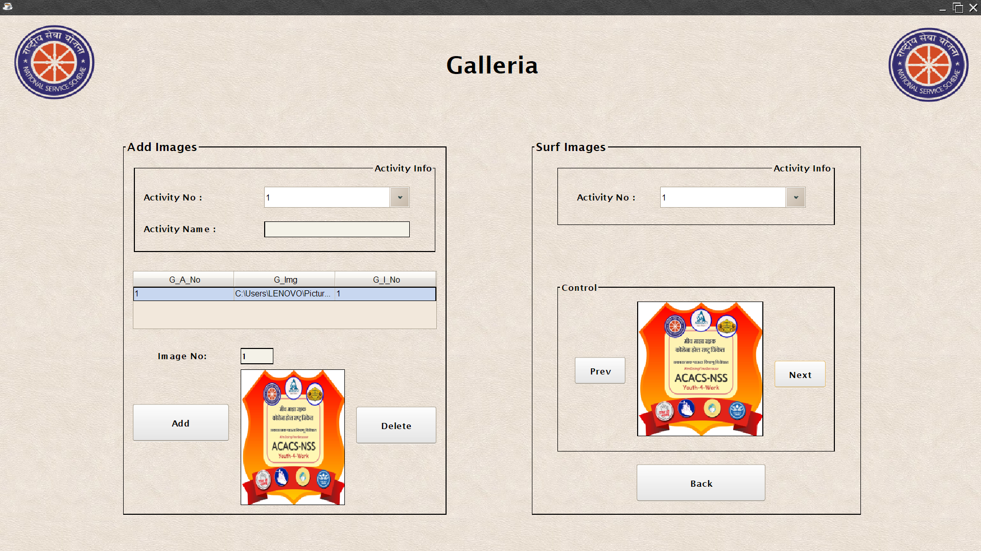
Currently working on photo gallery

Slide 40
Click Here to se video of System
https://youtu.be/KPgNUR0Uq9s

